Slide 1
Ecphrastic poetry & the development of professional literacy in computing

Slide 2
What is ecphrastic poetry?
Ecphrastic poetry is the conversation between two pieces of art. The writer interprets a work of visual art and then creates a narrative in verse form that represents his or her reaction to that painting, photograph, sculpture or other artistic creation.
http://www.firkinfiction.com/11.html

Slide 3
Ecphrastic poetry and computing
How do you write a computing-related poem in an ecphrastic manner?
Complete the following steps:
View a stimulus image and identify a computing-related concept it evokes.
If required, write down the concept, definition, law, formula etc.
Identify a suitable poetry type and write the poem.

Slide 4
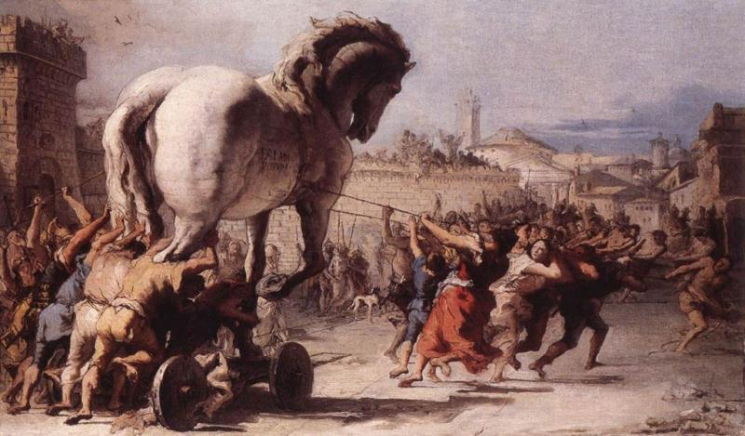
What concept does this image evoke?
http://www.chinaoilpaintinggallery.com/oilpainting/Giovanni-Domenico-Tiepolo/The-Procession-of-the-Trojan-Horse-in-Troy.jpg

Slide 5
Trojan Horse | ˅ Computer Viruses | ˅ Need to backup computer data

Slide 6
Example Haiku poem
Chaos reigns within.
Reflect, repent, and reboot.
Order shall return.
http://www.jokes2go.com/poems/7881.html?6

Slide 7
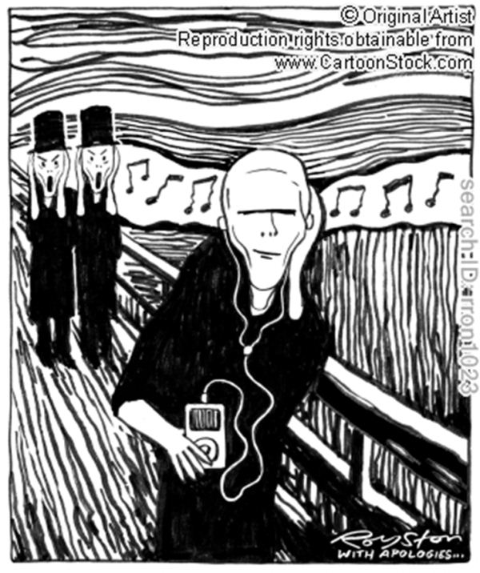
What concept does this image evoke?
http://www.cartoonstock.com/newscartoons/cartoonists/rro/lowres/rron1023l.jpg

Slide 8
The increasing de-socialisation of society through the utilisation of technology

Slide 9
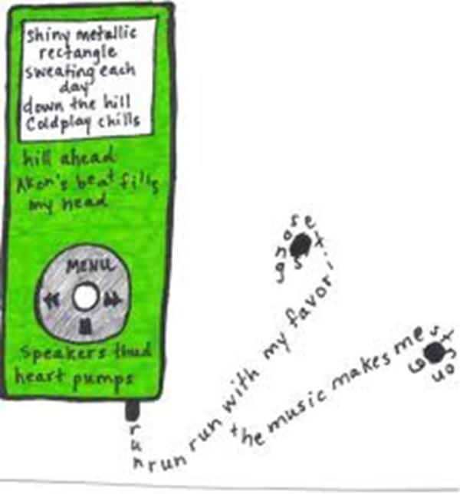
Example Concrete poem
http://bolee.files.wordpress.com/2009/02/ipod-concrete-poem.jpg%253Fw%253D329%2526h%253D354

Slide 10
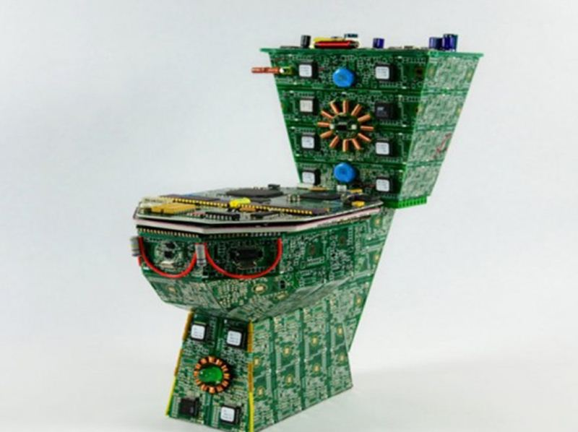
What concept does this image evoke?
http://inhabitat.com/nyc/wp-content/blogs.dir/2/files/2011/11/pcb-creations8-537x402.jpg

Slide 11
Computer CHIPs

Slide 12
Example Acrostic poem
Cost of production is low Hybrids combine chips with other devices
Integrated circuit is another name
Performance is high

Slide 13
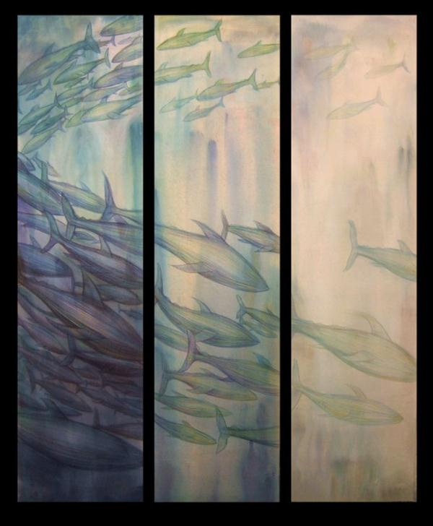
What concept does this image evoke?
http://1.bp.blogspot.com/-UgoFRESEFQ0/Tmgx3I4wrCI/AAAAAAAAAno/Z0foTy3ezxI/s1600/Losing-Color%252C-Painting-6-%2528b.gif

Slide 14
Computer technology is resource-intensive (power, ink etc.)

Slide 15
Example Limerick poem
My printer will drive me to drink
I’m always refilling its ink
it empties my purse
to make matters worse
it’s usually on the blink!
http://kingpoetry.com/limcomputer.htm

Slide 16
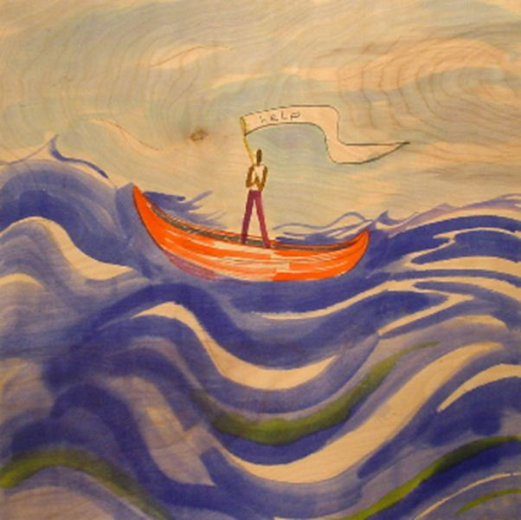
What concept does this image evoke?
http://lh6.ggpht.com/-3dA6r8JYyV8/Tfi4Jby80sI/AAAAAAAAACY/hnIPnyU0PcU/Redeemer_Pres-Help%252520Painting.jpg

Slide 17
Computer Helpdesk Support

Slide 18
Example Free Verse poem
If a packet hits a pocket on a socket on a port,
and the bus is interrupted as a very last resort,
and the address of the memory makes your floppy disk abort, then the socket packet pocket has an error to report!
If your cursor finds a menu item followed by a dash,
and the double-clicking icon puts your window in the trash, and your data is corrupted 'cause the index doesn't hash, then your situation's hopeless, and your system's gonna crash!
http://www.ahajokes.com/com047.html

Slide 19

What concept does this image evoke?
http://blog.pint.com/wp-content/uploads/1600x1200.jpg

Slide 20
Computer programmers and their accountability

Slide 21
Example Cinquain poem
Garbage
in, garbage out,
computer programmers
patiently explain - that means "Don't
blame us."
http://www.criticalpoet.net/forum/viewtopic.php?t=231&postdays=0&postorder=asc&start=40&sid=07f997fdfef8e4f8008e286925aabc45

Slide 22
What concept does this musical composition evoke?
Uptown Girl by the Billy Joel.

Slide 23
The Web (URLs)

Slide 24
Example re-worked song lyric
Uptown URL, you've been living in your virtual world I'll bet you've never had an inline .FLI I bet your webmaster never told you why I'm gonna try for an ... Uptown URL
It's even readable by the outside world As long as it can handle all the spam But now you're lookin' for a Photoshop man That's what I am!
http://www.poppyfields.net/filks/00240.html

Slide 25
Example re-worked song lyric
And when you notice the load, its uptime
And then you'll reboot, and see that your mine
You'll see that's its not so tough to serve out files all linked from...
an Uptown URL
You know, it'll be linked to all over the world
We'll even code in all your fancy toys
Even including interactive voice
They'll have a choice!
http://www.poppyfields.net/filks/00240.html

Slide 26
Activity
Using the given stimulus material, create the following types of poetry:
Free verse
Acrostic
Cinquain
Haiku
Limerick

Slide 27
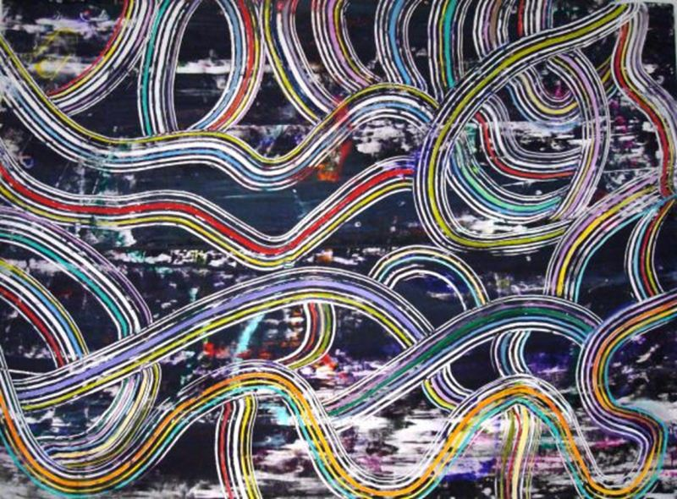
STIMULUS IMAGE 1
http://images.fineartamerica.com/images-medium/information-super-highway-angelo-ingargiola.jpg

Slide 28
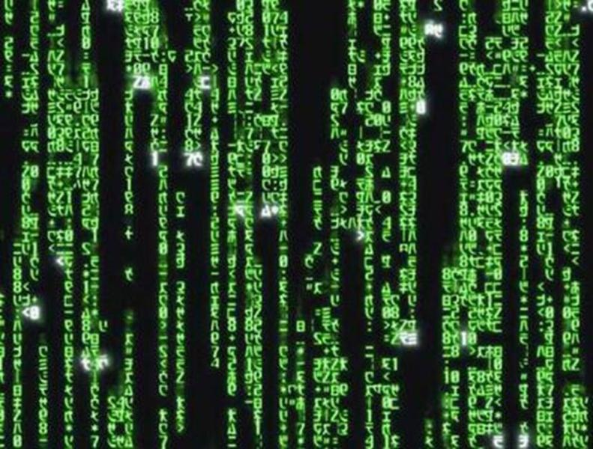
STIMULUS IMAGE 2
http://about-a-fish.com/wp-content/uploads/2010/03/the-matrix.jpg

Slide 29
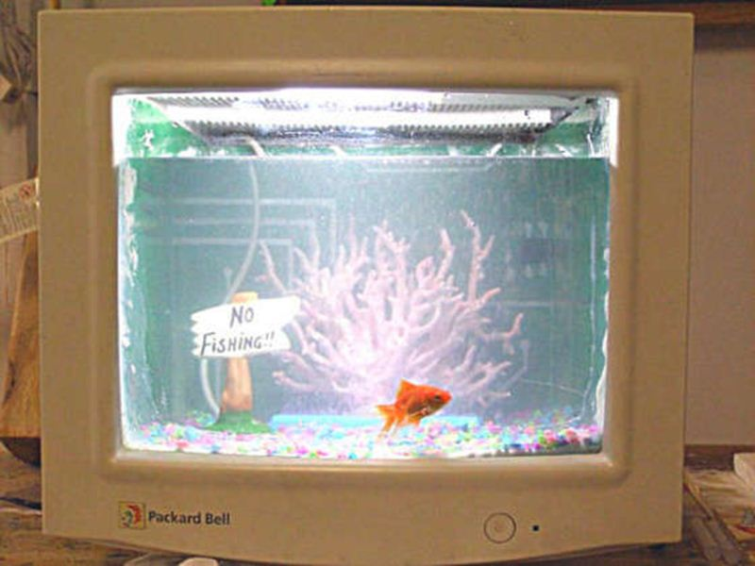
STIMULUS IMAGE 3
http://www.instructables.com/files/deriv/FVH/GPOB/F3KLNV83/FVHGPOBF3KLNV83.MEDIUM.jpg

Slide 30
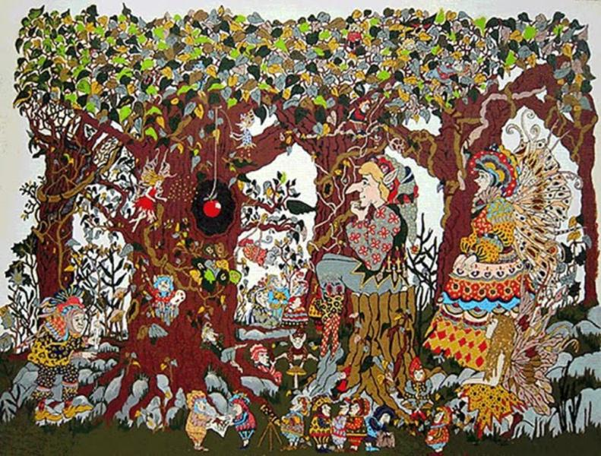
STIMULUS IMAGE 4
http://theplayfulpixies.blogspot.com/2010_04_01_archive.html

Slide 31
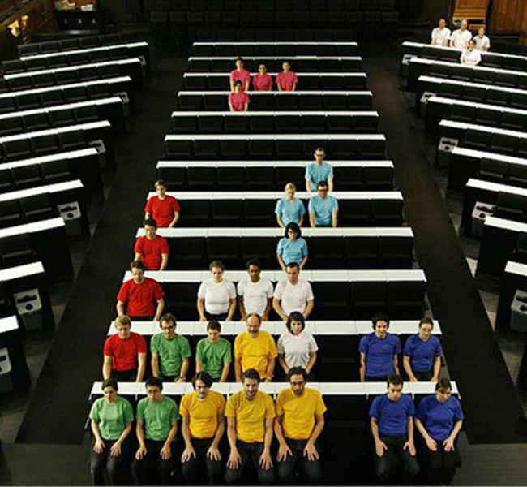
STIMULUS IMAGE 5
http://media.techeblog.com/images/stopmotion.jpg

